Slide 1
An Age of Big Business

Slide 2
Factors of Production
Change from Agriculture to Industrial because of the resources it possessed.
Land/Natural Resources
Labor
Capital

Slide 3
Raising Capital (Money for Investment)
Corporations sell stock→ People invest in stock and become shareholders → When corporations make profits they pay dividends to shareholders

Slide 4
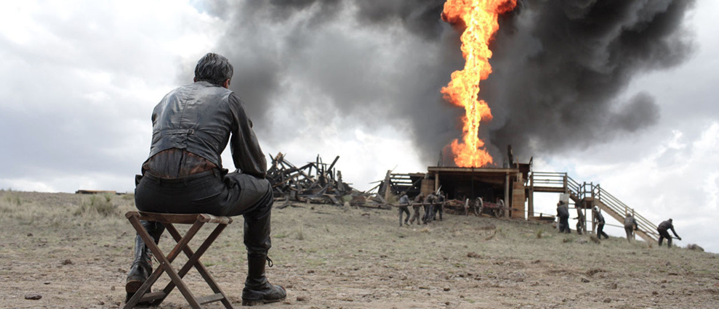
The Oil Business
Before petroleum oil, whale oil was used for lamp fuel→ Figure out how to refine oil and start using Kerosene
Edwin Drake strikes oil in Pennsylvania. Starts oil boom.

Slide 5
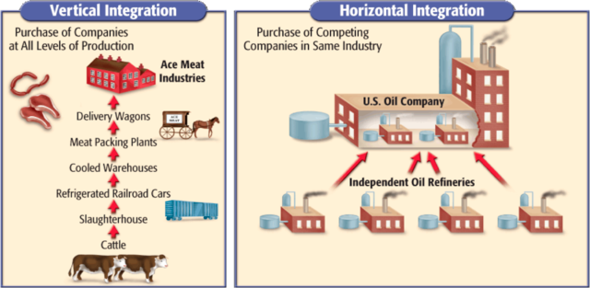
John D. Rockefeller and The Standard Oil Trust
Rockefeller creates Standard Oil Company that revolutionized business.
Lowered Prices to drive competitors out of business, pressured customers to avoid rivals, got special discounts from railroads.
He uses horizontal integration and later vertical integration to create a monopoly in oil business

Slide 6
Question
Why might laws be passed to control monopolies?

Slide 7
The Steel Business and Andrew Carnegie
History Channel Video
Vertical Integration

Slide 8
Fighting Monopolies and Trusts
Consumers were being hurt by the lack of competition within industries. No reason for companies to keep low prices or evolve.
Congress passes Sherman Antitrust Act which prohibited these trusts and monopolies.
Did little to curb power of big business.

