Slide 1
Communism vs. Capitalism
Both are economic systems. The true form of both these systems does not exist.

Slide 2
Capitalism vs. Communism The Theories of Each
Communism | Capitalism
Everyone is equal (No matter your education or abilities) | All businesses are privately owned
Everyone shares in ownership of production(No privately owned business). | No government intervention in business
No Social Classes | Social Darwinism-the strongest will survive the “lazy and weak” will not succeed.
Looking at these two systems what are some positives and negatives about each system?
Why can neither of these exist in their true form in today’s world?

Slide 3
Communism vs. Capitalism What these look like in practice
Communism | Capitalism
Government controls all production of major businesses and industry | Government will step in to help balance the power between business owners, workers and consumers. (Minimum wage laws, anti-trust/monopolies, etc.
Through the rule of a dictator government controls many of life’s choices for their people | Competition amongst businesses, rather than the government, sets prices and choices for consumers.
There is a very small middle class and many of the people live in poverty | There is a very strong middle class and programs are established to help the poor
Countries using these in the 1920s:
Communism Russia
Capitalism USA

Slide 4
The US in the 1920s
Most people in the United States viewed anything other than capitalism as anti-American and threatening to the pursuit of the “American Dream”.
This included Communists, and Anarchists (people who believe in no government at all).
Americans began to associate communism and anarchy with foreign immigrants. Tensions began to rise as Americans viewed immigrants as threatening to the American way of life.

Slide 5
Red Scare
Palmer Raids – thousands of immigrants arrested and deported for suspicion of Communism,
Many without sufficient evidence
Alien Act – pg. 303

Slide 6
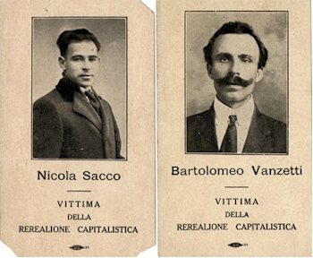
Sacco and Vanzetti

Slide 7
Demobilization
Transition from war time to a peace time economy

Slide 8
Distrust of Labor Unions
1919 Steel Workers Strike
1919 Boston Police Strike

Slide 9
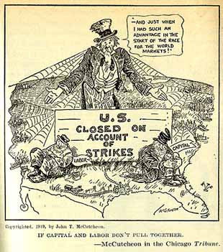

Slide 10
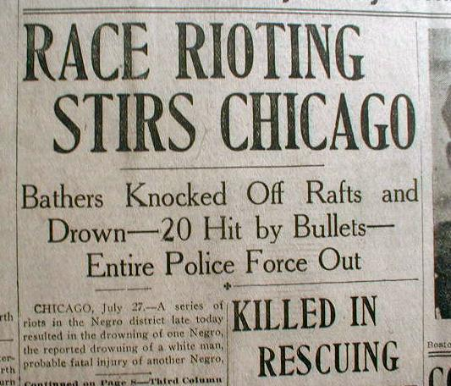
Racial Tensions Increase

Slide 11
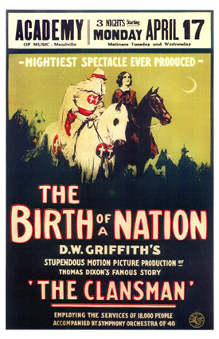
A Birth of a Nation

Slide 12
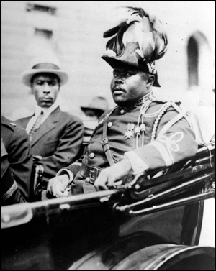
Marcus Garvey – “back to Africa”

Slide 13
Warren G. Harding
Preached “normalcy” and isolationism
Scandals – the Ohio Gang, Tea Pot Dome Scandal

Slide 14
Calvin Coolidge “Silent Cal”
Offered to fight against corruption
A huge supporter of big business

