Slide 1
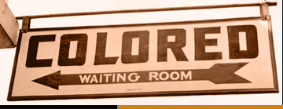
American History
The End of Reconstruction

Slide 2
Compromise of 1877
Rutherford B. Hayes is elected President
He agrees to remove all Northern troops from the South
Reconstruction is officially over with white southerners back in charge

Slide 3
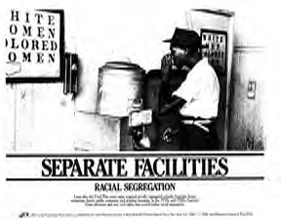
What does this mean for African Americans?
Segregation
- Separation of races in all facets of society

Slide 4
Segragation in the South
Jim Crow Laws
Plessy v Ferguson
Laws that enforced segregation in all public places
Examples: restrooms, water fountains, restaurants, parks, etc.
Homer Plessy was of mixed race and was required to ride in the black car of a train in LA
He challenged this law and the case went to the Supreme Court

Slide 5
Plessy v Ferguson
The Supreme Court declared “separate but equal” (know this!)
Segregation is Constitutional or legal as long as both races are treated equally
What problems do you see with this decision?
“The slave went free; stood a brief moment in the sun; the moved back again toward slavery” (W.E.B. Du Bois pg. 98).
Write a paragraph explaining the meaning of this quote.

