Slide 1
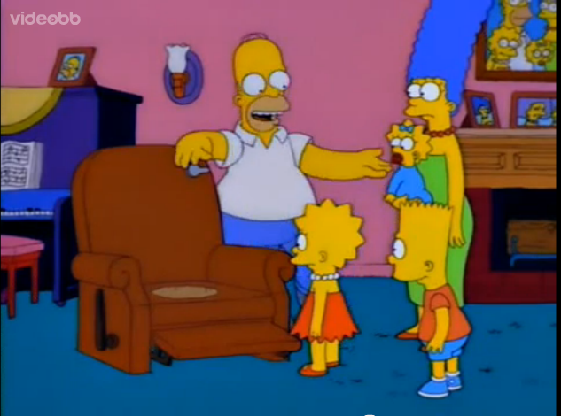
Inventions
Lazy-Boy Toilet
Makeup Shotgun

Slide 2
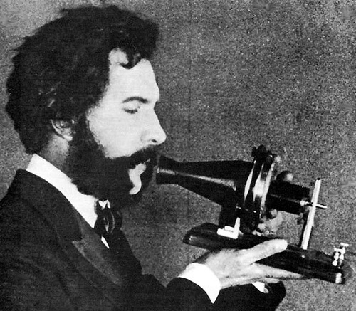
Communication
Telegraph
Telephone

Slide 3
Question
How did the telegraph revolutionize communication?

Slide 4
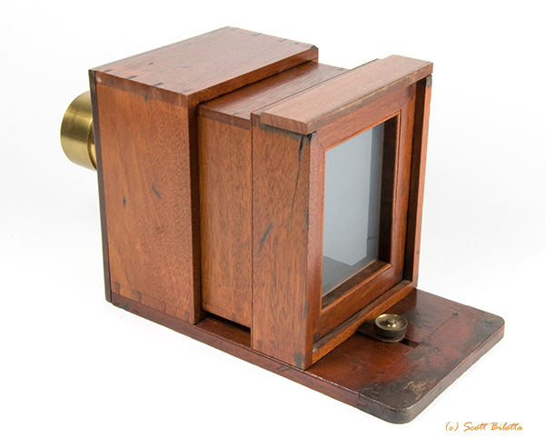
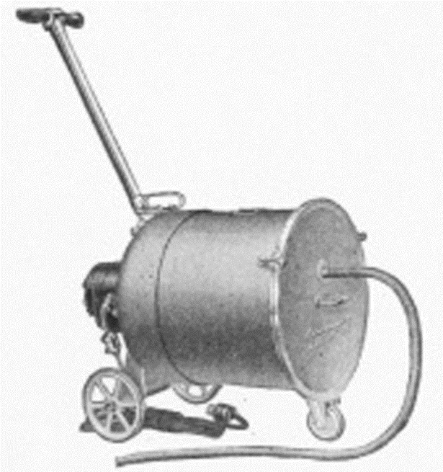
Leisure
Small Box Camera
Vacuum

Slide 5
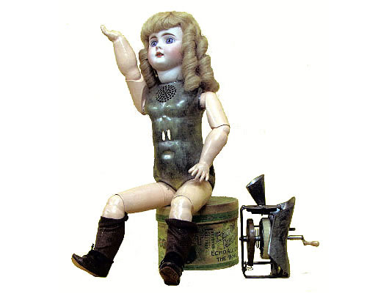
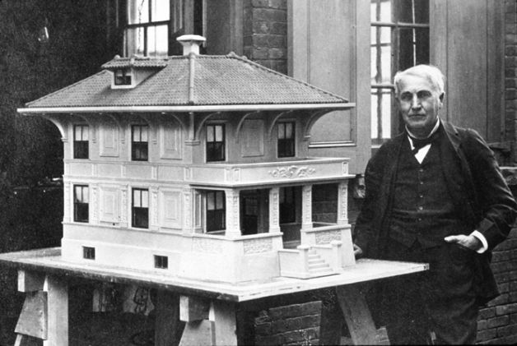
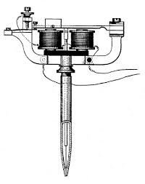
Thomas Edison Inventions The Best of the Rest
Talking Doll
Cement House
Electric Tattoo Machine

Slide 6
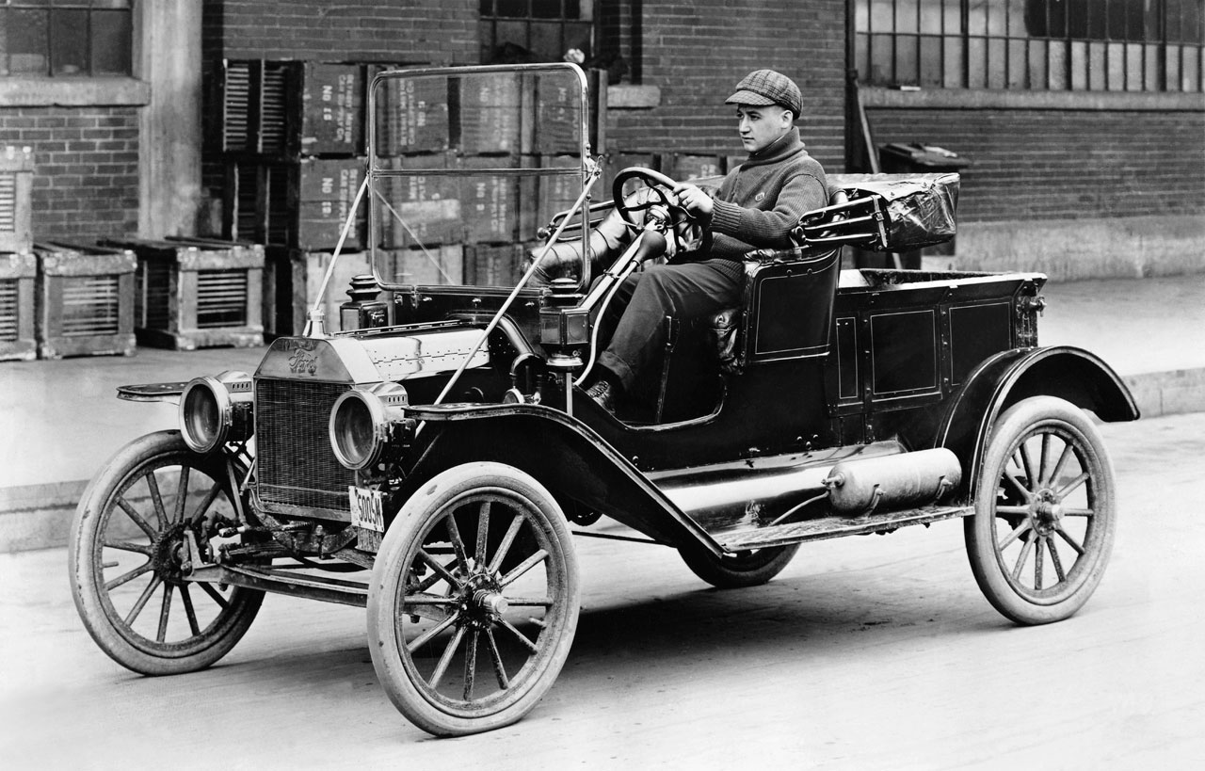
The Automobile and Henry Ford
Henry Ford transformed industry by implements the assembly line to manufacture goods.
Did Henry Ford invent the assembly line? No. The meat packing industry had been perfecting it for years. He just flipped it around.
The assembly line will allow manufactures to mass produce their goods to decrease manufacturing cost and sold more cheaply.

Slide 7
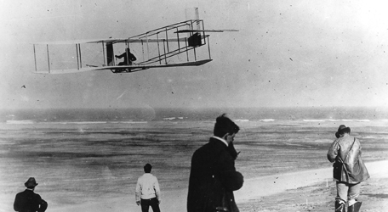
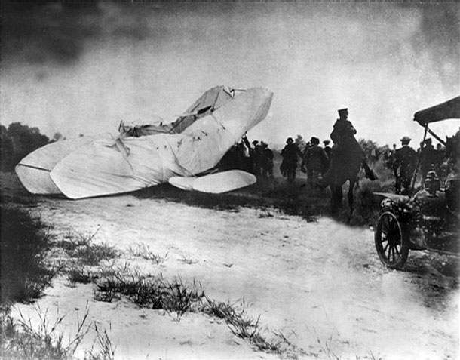
Airplane
First Flight by Wright Brothers
First Crash on Record

