Slide 1
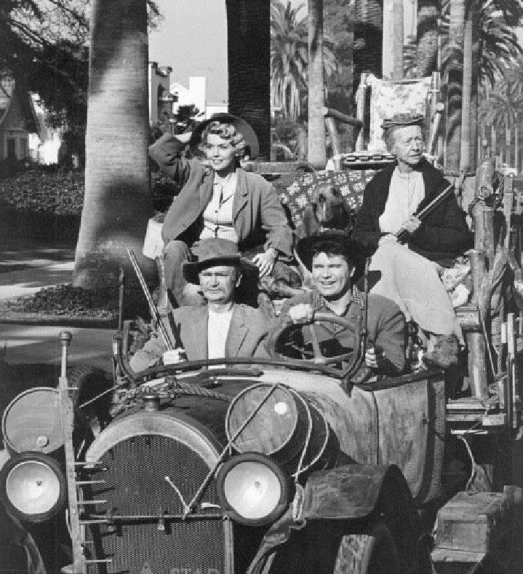
Moving to the City

Slide 2
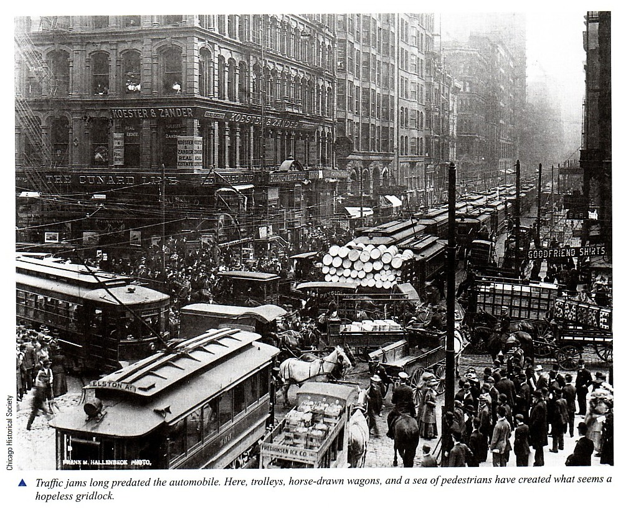
Growth of Cities
1870- 1 in 4 Americans lived in Cities
By 1910 nearly half Americans were city dwellers
Major cities such as New York, Chicago, and Detroit had immigrant populations of 80% or more
Reasons Behind Growth of Cities
Industrialization of Farming
Women’s role changed in rural areas
African Americans escaping south
Railroads
Nearby Resources
Seaports

Slide 3
City Life
Poor
Lived in tenements—run down apartment buildings-- located in the slums of cities.
Multiple people per room.
Several families share bathroom and sink
Middle Class
Doctors, lawyers, ministers, managers, and officer clerks were typical jobs for this class.
Many moved to suburbs where they enjoyed hot water, indoor toilets, and by the 1900’s electricity.
The Very Rich
Built huge mansions in the city and vast country estates.
Because of their extravagant luxury—and the terrible poverty that lay beneath it– they call this the Gilded Age
Gilded refers to something that’s covered with a thin layer of gold

Slide 4
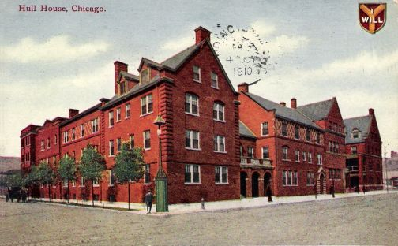
Cities in Crisis
Garbage and Human & Animal waste helped spread disease inside packed cities
Extreme poverty led to high crime rates
Orphaned and homeless children resorted to crime
Gangs form in poor neighborhoods
Groups form to help the poor and create settlement houses.
Most famous of these was Hull House

Slide 5
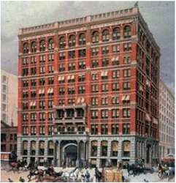
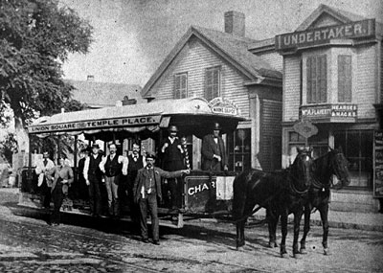
The Changing City
Due to limited space there was a need to build upwards and not outwards.
Skyscrapers with an iron and steel frame and elevators
Fairgrounds and Parks began to be built in an effort to help city dwellers enjoy the beauties of nature.
Streetcars pulled by horses, Cable Cars, Trolley Cars, and eventually the Subway provide public transportation.
Huge steel bridges built.

