Slide 1
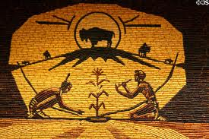
Native American Life 1860-1880

Slide 2
Cornell Method; Structure

Slide 3
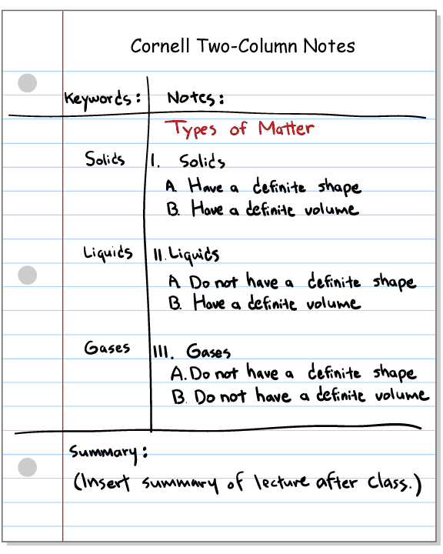
Example of Cornell Method

Slide 4
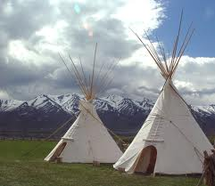
Cornell Method applied to Native American Culture
Students will apply the following subtopics in a Cornell Method note taking method:
Mode of Survival
Housing
Daily Life
Use of Land
Views of Railroad
Obstacles

