Slide 1
Opening the West
Chapter 4

Slide 2
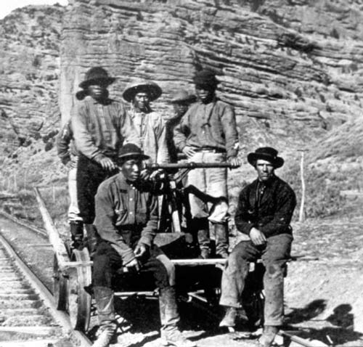

Slide 3
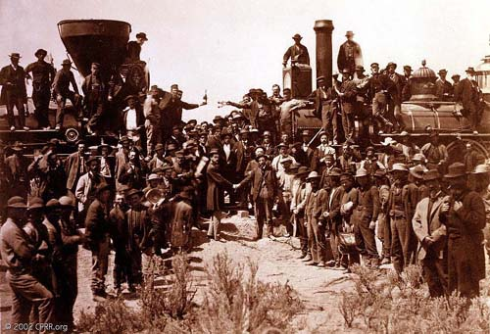

Slide 4
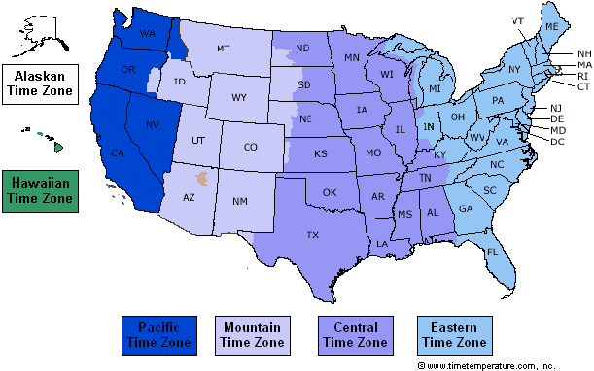

Slide 5
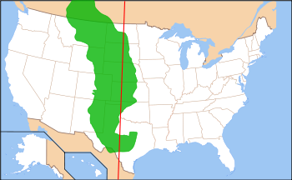

Slide 6
DIRECTIONS
Turn to page 121 (The Homestead Act)
Make this list in your notes section
1. WHO could take advantage of this act?
2. WHAT were the requirements of the act?
3. WHEN was the act passed?
4. WHERE did the act apply?
5. WHY was the act passed?

Slide 7
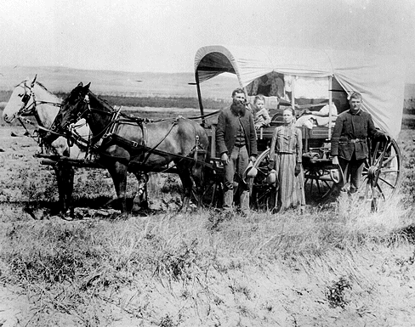
Homestead Family

Slide 8
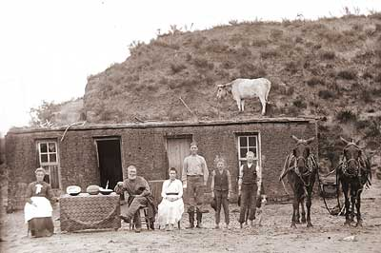
Sod House

Slide 9
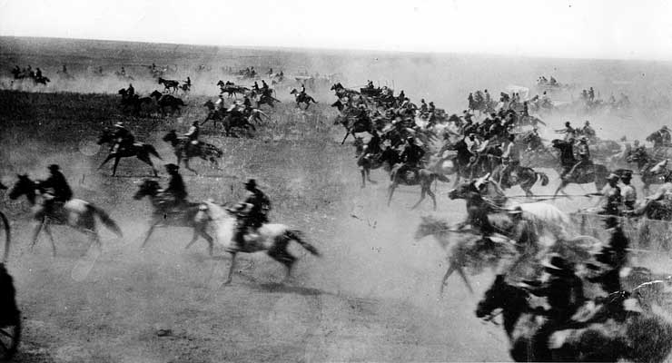
Oklahoma Land Rush

Slide 10
