Slide 1
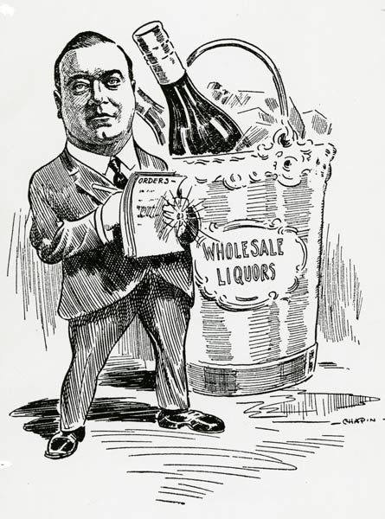
The Progressive Movement

Slide 2
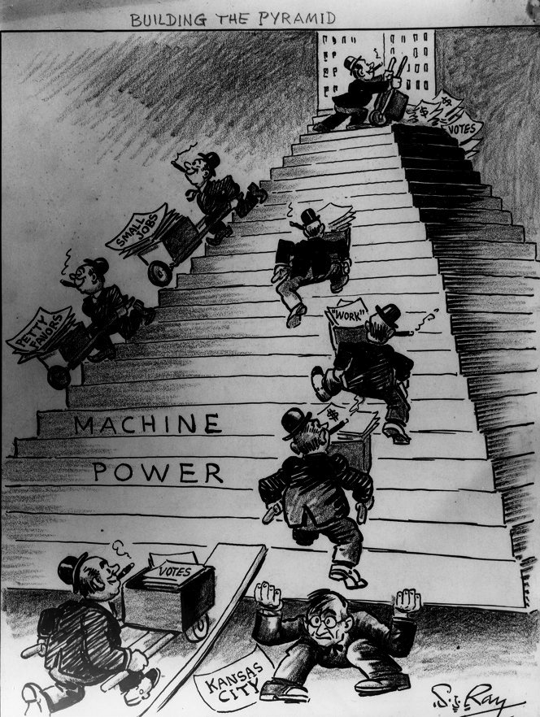
Fighting the Political Machine
Political Machines—powerful organizations linked to political parties– that controlled local governments
Political Districts were controlled through the machine’s influence on government jobs and services
Accepted bribes, campaign contributions, and illegal kickbacks.

Slide 3
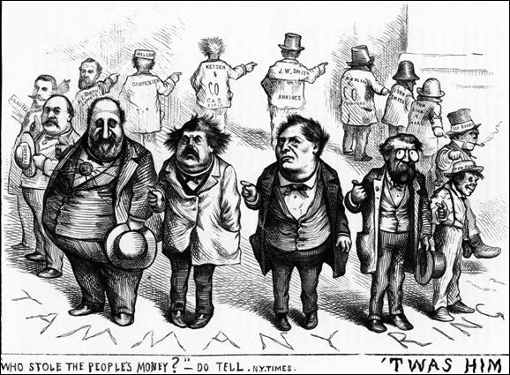
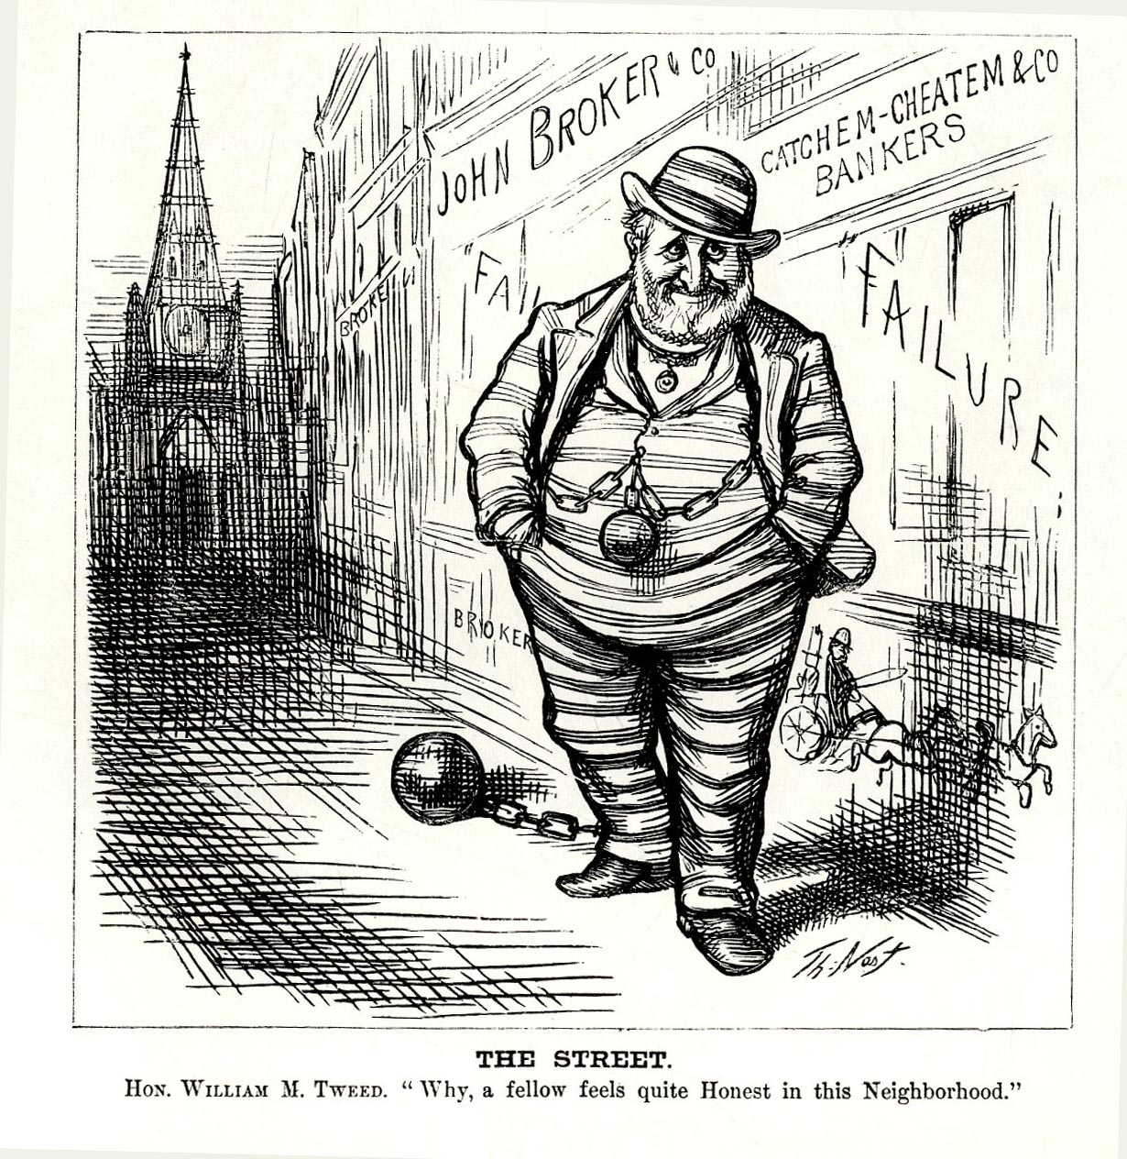
Boss Tweed
William M. “Boss” Tweed ran the NYC Democrat political machine in 1860’s & 1870’s.
Led group of corrupt politicians known as Tweed Ring.
Collected millions of dollars in illegal payments from companies who did business with the city.
Harper’s Weekly Cartoonist Thomas Nest exposed Ring and Tweed was convicted and sentenced to prison

Slide 4
The Spoils of Democracy
Since the early days of the United States, political supporters were rewarded with jobs and contracts.
President’s Garfield and Hayes tried to reform the civil service (non-elected government workers).
Neither party backed the reform
Finally the Pendleton Act was passed in 1883, and the Civil Service Commission was created.

Slide 5
Video Clip

Slide 6
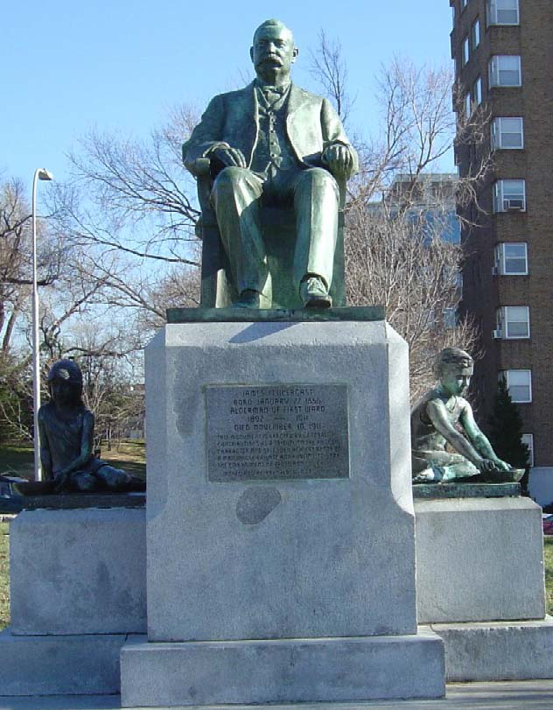
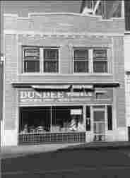
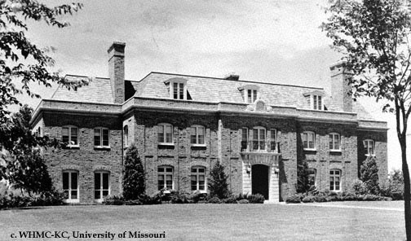
The Pendergast Brothers
James “Big Jim” Pendergast
Tom “Boss Tom” Pendergast

Slide 7
Controlling Business
Sherman Anti-Trust Act-first federal law to control trusts and monopolies
Not used against business but unions
The Railroad Oligopoly—a few large companies that controlled the railroad.
Interstate Commerce Act- required to charge reasonable and just rates
Lowered Tariffs
Republicans raised tariffs to protect American business from foreign competition
Though these high tariffs made goods more expensive

Slide 8
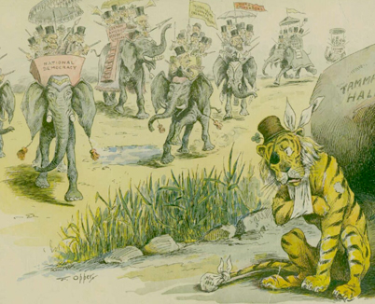
New Reformers
Socialists wanted government to control industry and major resources.
Progressives wanted government to regulate business.
Muckrakers- reporters who exposed corruption
The Jungle helped pass the Meat Inspection Act and Pure Food and Drug Act.

Slide 9
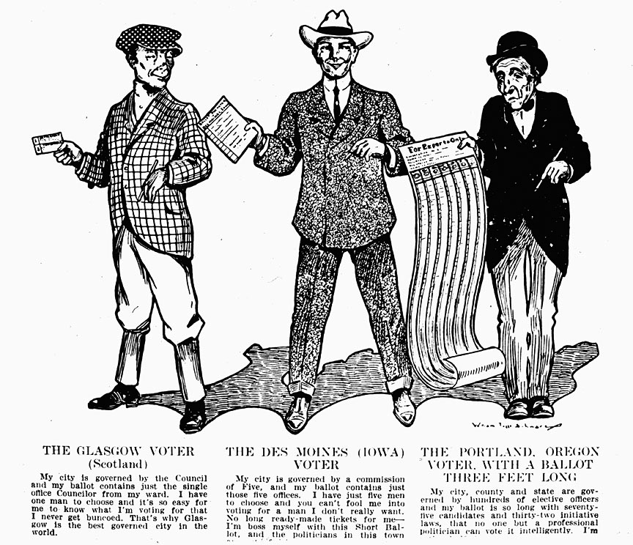
The Oregon System
With the initiative, voters could place issue on ballot in a state election→ Voters could accept or reject measures that state legislation enacted with referendum→ Recall allowed voters to remove elected officials.

Slide 10
17th Amendment
To take power away from Political Machines, Senators would be directly elected by the people.

