Slide 1
1920s Prohibition

Slide 2
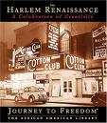
Harlem Renaissance

Slide 3
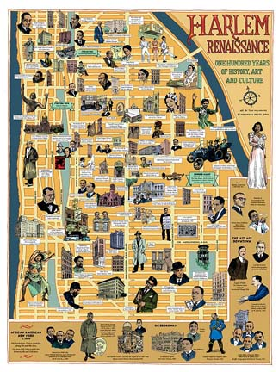
Harlem Renaissance

Slide 4
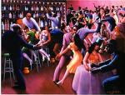
Harlem Renaissance

Slide 5
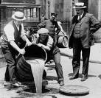
18th Amendment

Slide 6
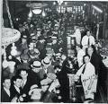
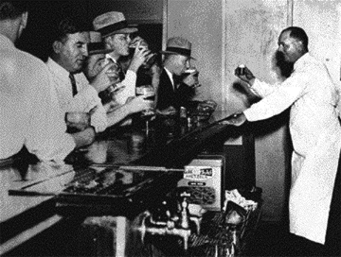
Speakeasies

Slide 7
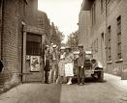
Speakeasies

Slide 8
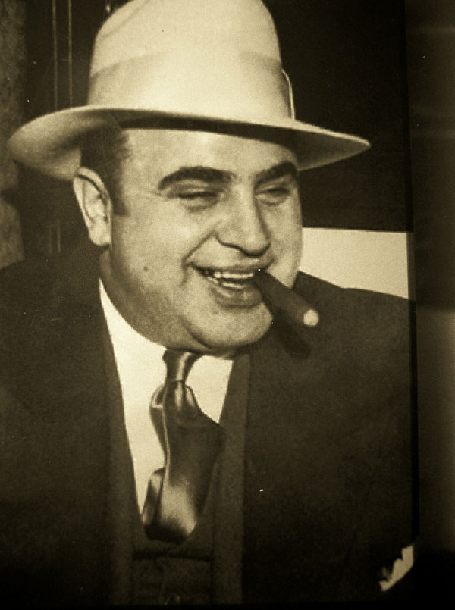
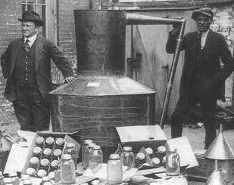
Bootleggers
Al Capone

Slide 9
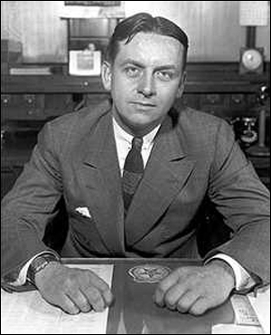
Capone vs. Ness
Al Capone
Eliot Ness

Slide 10
Thompson Machine Gun

Slide 11
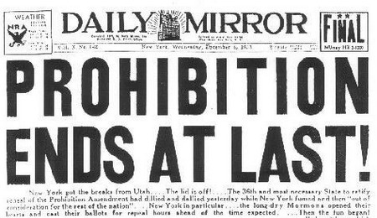
21st Amendment

Slide 12
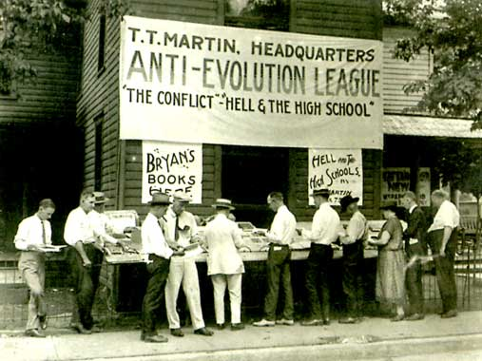
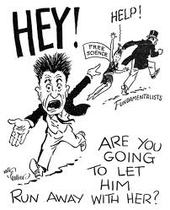
Scopes Trial

Slide 13
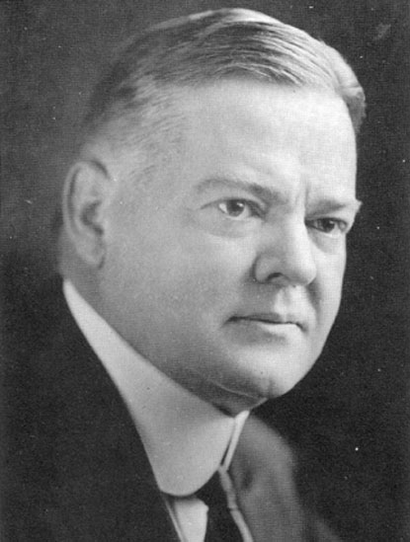
Herbert Hoover

