Slide 1
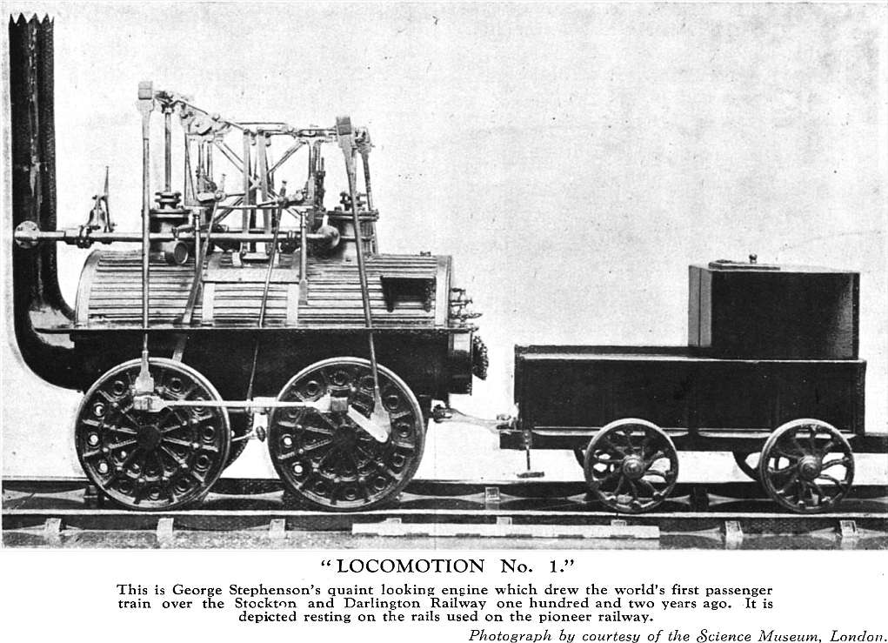
Railroads Lead the Way

Slide 2
Railroad Expansion
Following the Civil War, the railroad system drove economic growth.
Immigrants and minorities were among the thousands of laborers who helped expand the railroad from 30,000 miles of track in 1860 to 193,000 miles of track in 1900.
Larger railroad companies began consolidating—combining companies– with smaller companies or driving them out of business.
This consolidation made larger companies more efficient and allowed companies to establish standard prices and more uniform service.

Slide 3
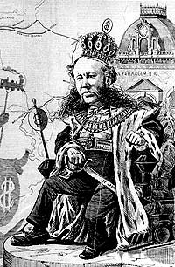
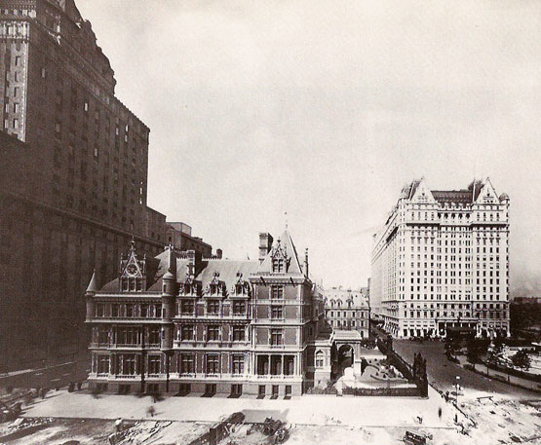
Railroad Barons
Railroad consolidation turned a few railroad owners into railroad barons who controlled the nations rail traffic.
Cornelius Vanderbilt was one of the first railroad barons and becomes one of the richest men in the world.
These barons were extremely cut throat businessmen in an age of few laws and regulations for businesses.

Slide 4
Question
What are the advantages and disadvantages of consolidation?

Slide 5
Railroad Stimulates Economy
Railroads transported raw materials, manufactured goods, produce, and livestock.
The construction of the railroads helped many American industries grow. The steel and lumber industries greatly benefited from railroad expansion.
Railroad companies provided thousands of jobs.

Slide 6
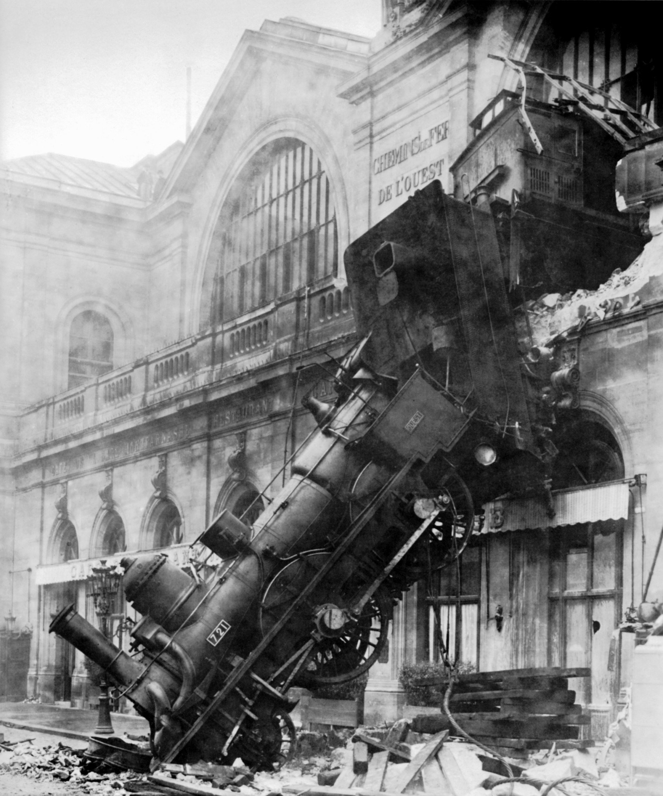
Improving the Railroads
With so many railroads being built across the country, standardization was greatly needed within the industry.
The standard gauge was adopted (4ftx8.5in.) to make railroad track width uniform.

Slide 7
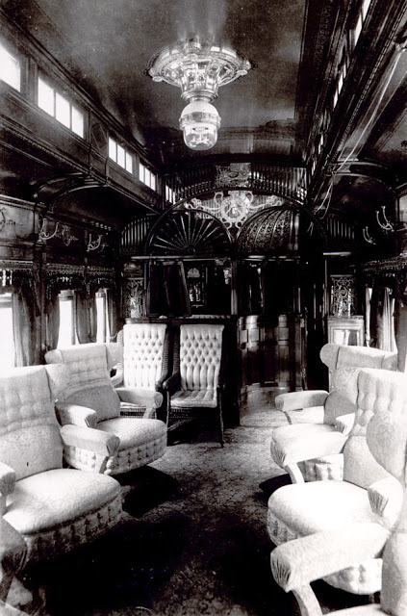
Railroad Technology
Four new technologies help improve railroads:
Air Brakes
Janney Car Couplers (made it easier to link train cars)
Refrigerated Cars
Sleeping Cars

Slide 8
Competing for Customers
Railroad companies competed fiercely for customers.
Large railroad companies would offer secret discounts, rebates, for their big customers to undercut small companies. Many of these small companies were forced out of business because they could not compete.
These discounts were made up by the railroad companies by charging smaller customers higher rates.
Railroad barons made secret deals with each other called pools. These pools divided business among members and set rates. With no outside competition, barons charged higher rates and earned bigger profits.

Slide 9
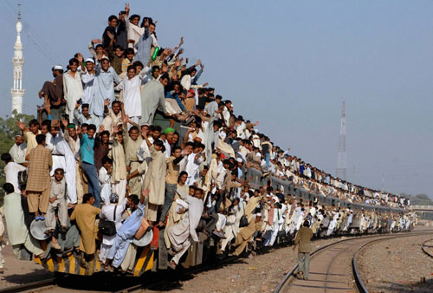
Task
Name 2 technologies that improved railroad travel. Explain.

