Slide 1
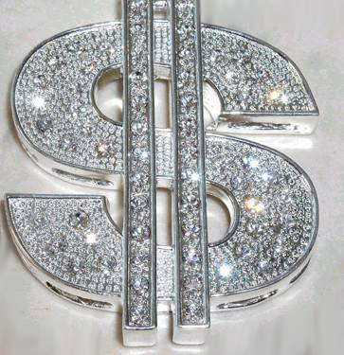
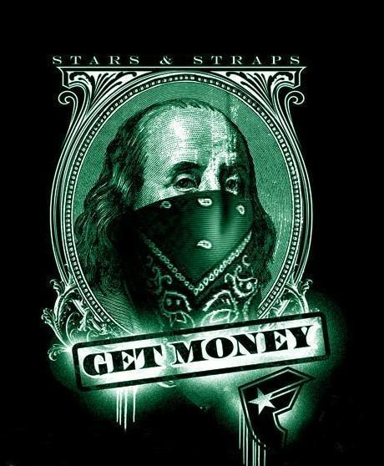
Lifestyles of the Rich and Robber Barons

Slide 2
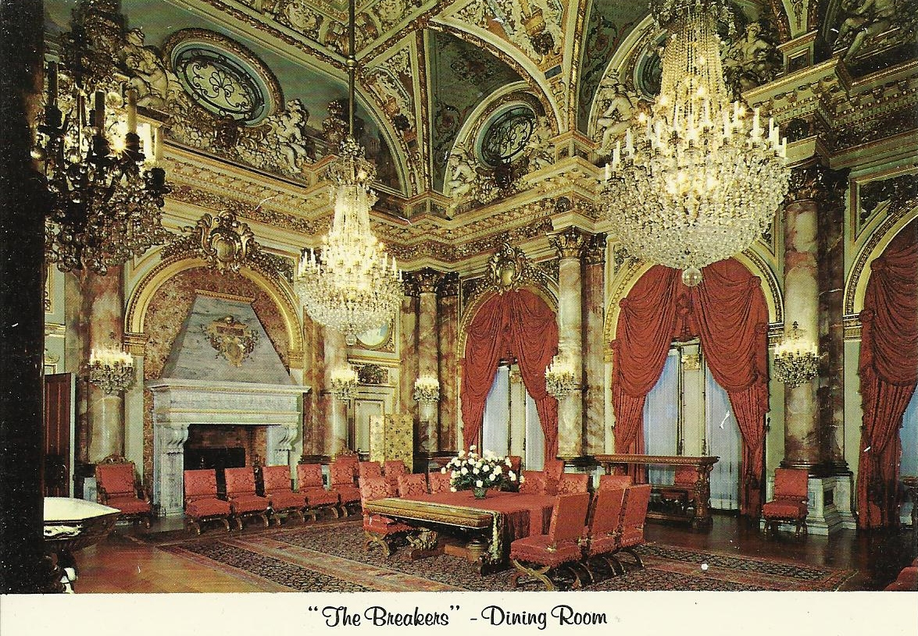
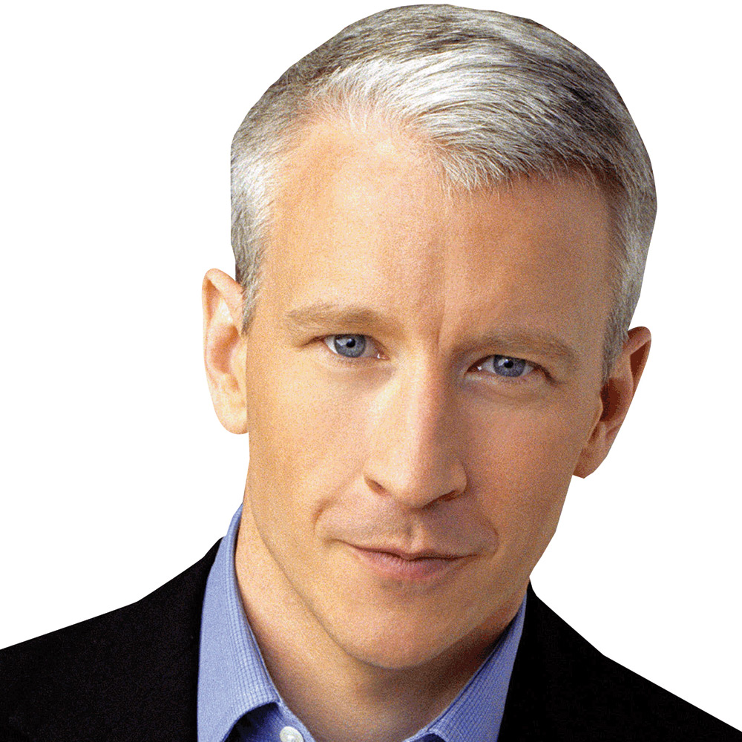
Cornelius Vanderbilt
Railroad and Steamboat Baron
“What do I care about the law. Ain’t I got the power?”
Worth $100 million at his death ($143 Billion today)
One of his many arch enemies was Mark Twain who accused him of having no soul.
Great grandson is Anderson “The Silver Fox” Cooper.

Slide 3
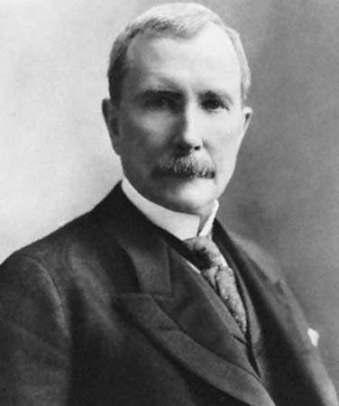
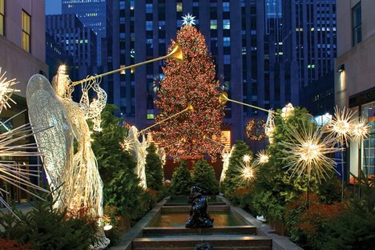
John D. Rockefeller
Oil Baron
“God gave me my money.”
Father was a Snake Oil salesman.
Company he created—Standard Oil-- was ruled a monopoly and split into 34 companies (Conoco, Amoco, Chevron, Exxon Mobile)
Donated $550 million of his $900 billion fortune.

Slide 4
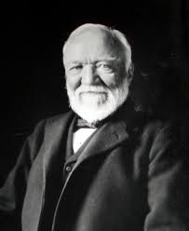
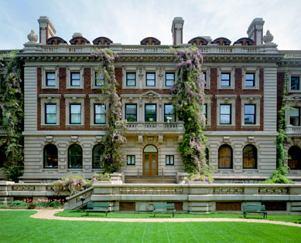
Andrew Carnegie
Steel Baron
Scottish Immigrant
Preached the “Gospel of Wealth”-- that barons should not only accumulate wealth but should distribute wealth to help others.
1892 Homestead Strike
Worth $400 million, gave away $380 million.

Slide 5
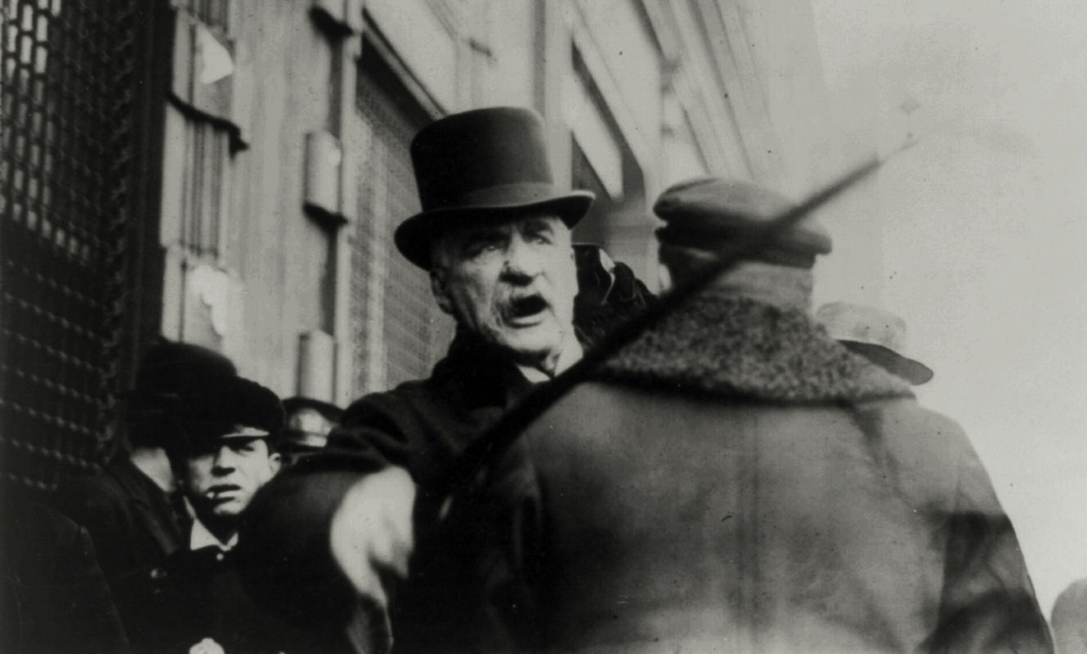
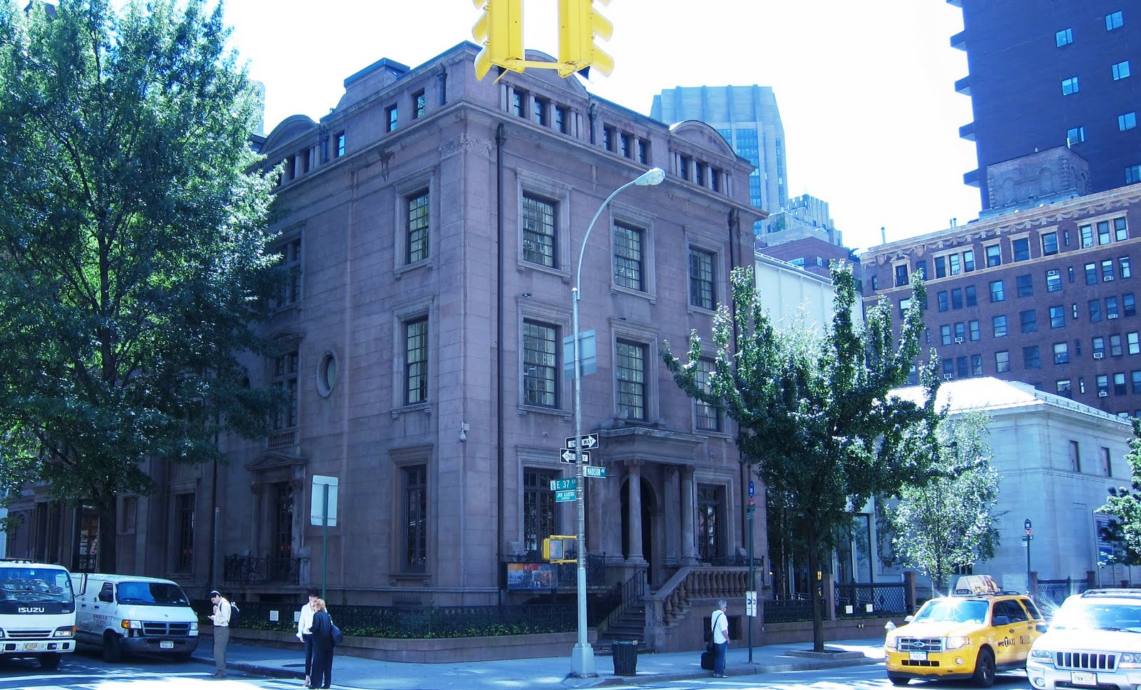
JP Morgan
Finance/Banking Baron
“We are not in business for our health.”
Helped form General Electric, US Steel, and The New York Times.
Was viewed as the most powerful man in America.
Archenemy was Teddy Roosevelt.
Spent $60 million ($900 million today) on art.
His uncle wrote the song “Jingle Bells”.

