Slide 1
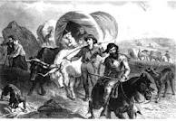
Settlers on the Plains

Slide 2
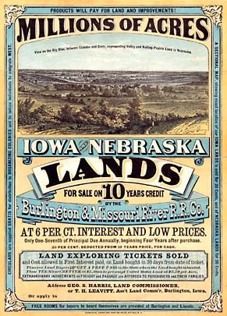

Slide 3
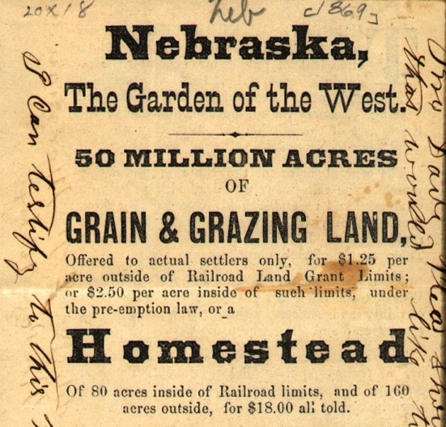

Slide 5
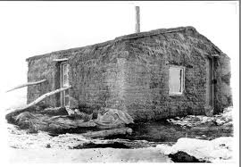
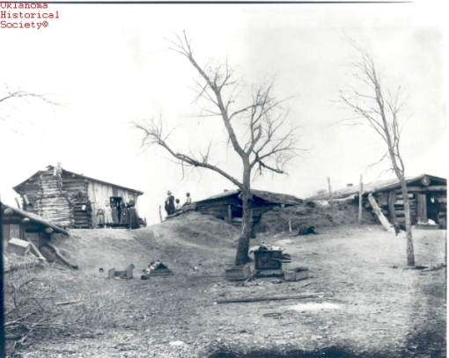
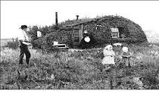
Housing
Dugouts-build in earth (problems: construction/solid?)
Soddies-built of earth (problems: snakes/spiders)
Stone (problem-scarcity)

Slide 6
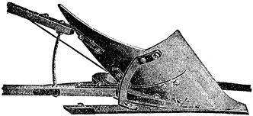
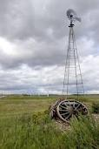
Technology
Early wooden plows couldn’t penetrate the soil enough
Steel plows increase production
Barbed wire and wind mills increase

Slide 7
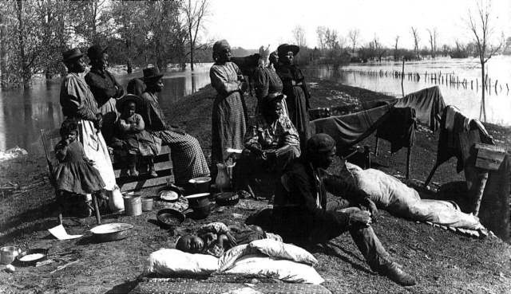
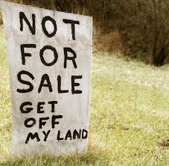
Land Ownership Concepts
Tracts of land sold by rail companies to farmers
Exodusters: AA’s going west to escape South
Advertisements entice people to go to MN/ND
COULD OWN LAND!!

Slide 8
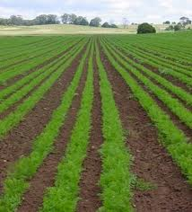
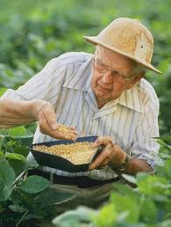
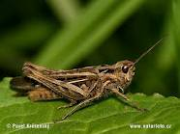
Typical Day
Farming for men, or hunting
Children helped with farming-little education
Women were active contributors to the farm-expanded role
Challenges: droubt, cold, grasshoppers, labor, flooding in MW

Slide 9
Why would a farmer see the railroad as beneficial/necessary?
What problems can you see with the farmers dependency on the railroad?

