Slide 1
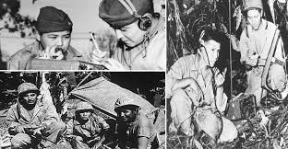
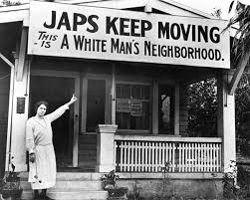
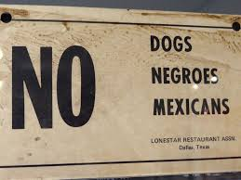
Describe how the following documents convey the social issues found (on the homefront and in our forces) during wwii:
5) 6)
1)
2)
3)
4)

